Slide 1
LEAD SCORING CASE STUDY
Presented By:- Snehal Kanifnath Pansare

Slide 2
Objective:- 1. Build a logistic regression model to assign a lead score between 0 and 100 to each of the leads which can be used by the company to target potential leads. A higher score would mean that the lead is hot, i.e. is most likely to convert whereas a lower score would mean that the lead is cold and will mostly not get converted. 2. There are some more problems presented by the company which your model should be able to adjust to if the company's requirement changes in the future so you will need to handle these as well. These problems are provided in a separate doc file. Please fill it based on the logistic regression model you got in the first step. Also, make sure you include this in your final PPT where you'll make recommendations.

Slide 3
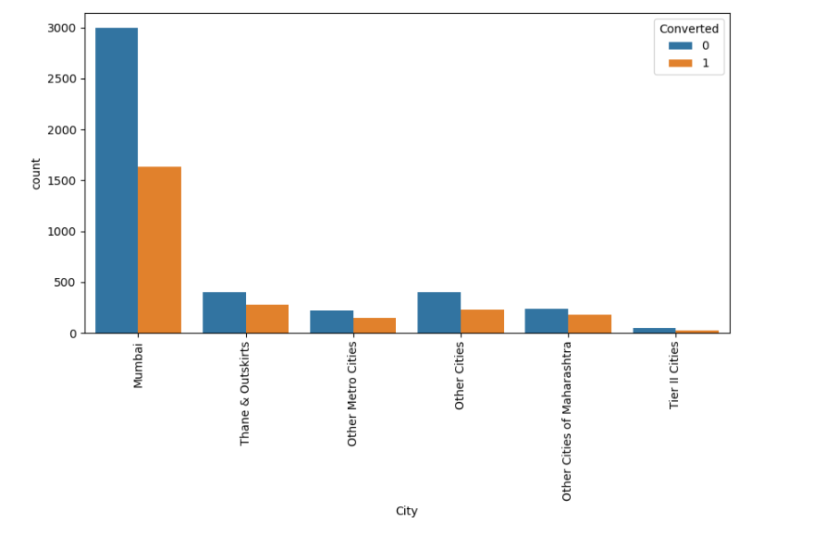
Spread of City columnn after replacing NaN values

Slide 4
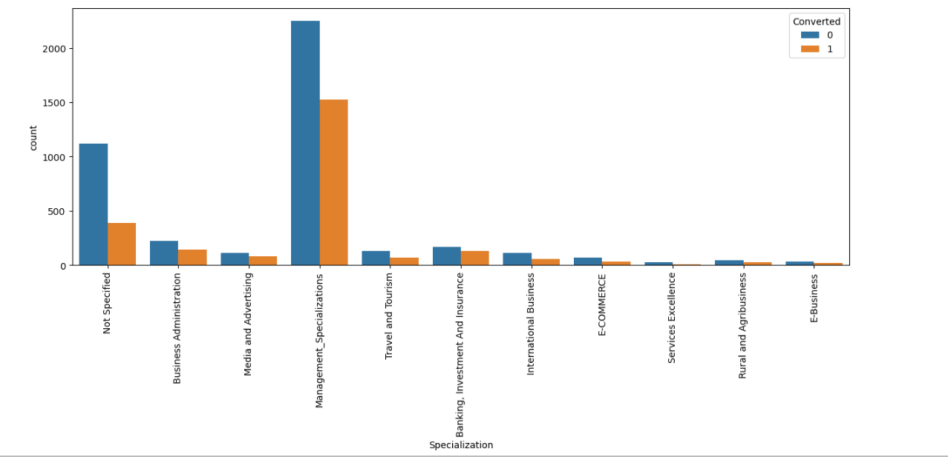
Spread of Specialization columnn

Slide 5
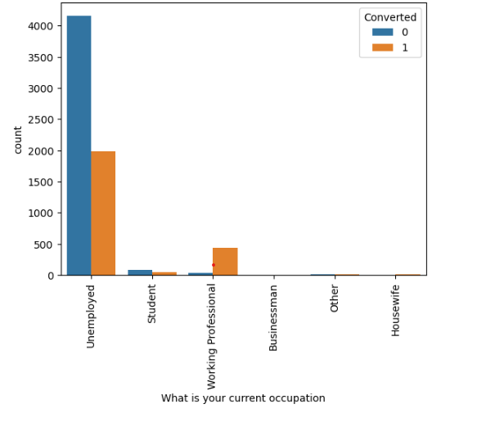
Count of Variable based on Converted value for “What is your current occupation”

Slide 6
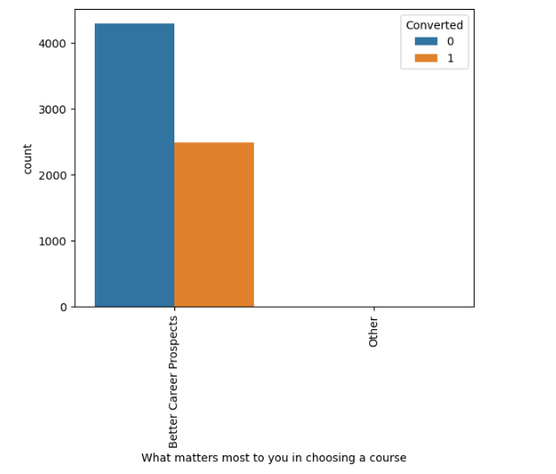
Count of Variable based on Converted value for “What matters most to you in choosing a course”

Slide 7
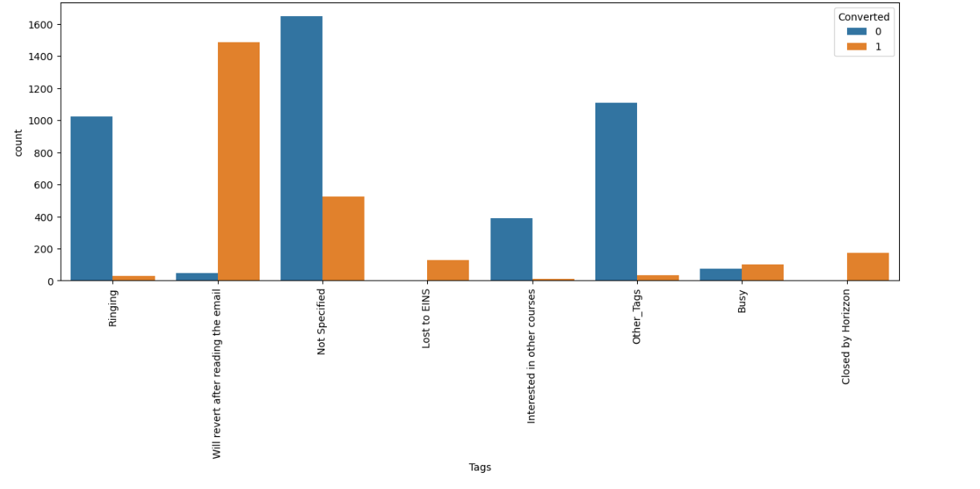
Count of Variable based on Converted value for “Tags”

Slide 8
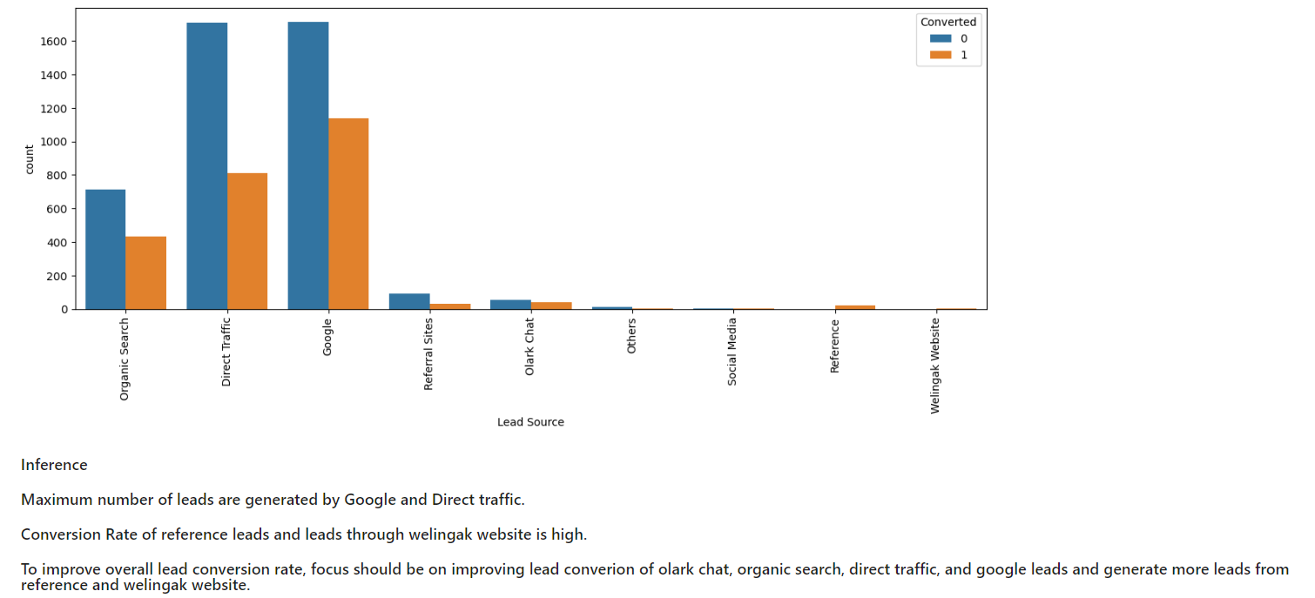
Count of Variable based on Converted value “Lead Source”

Slide 9
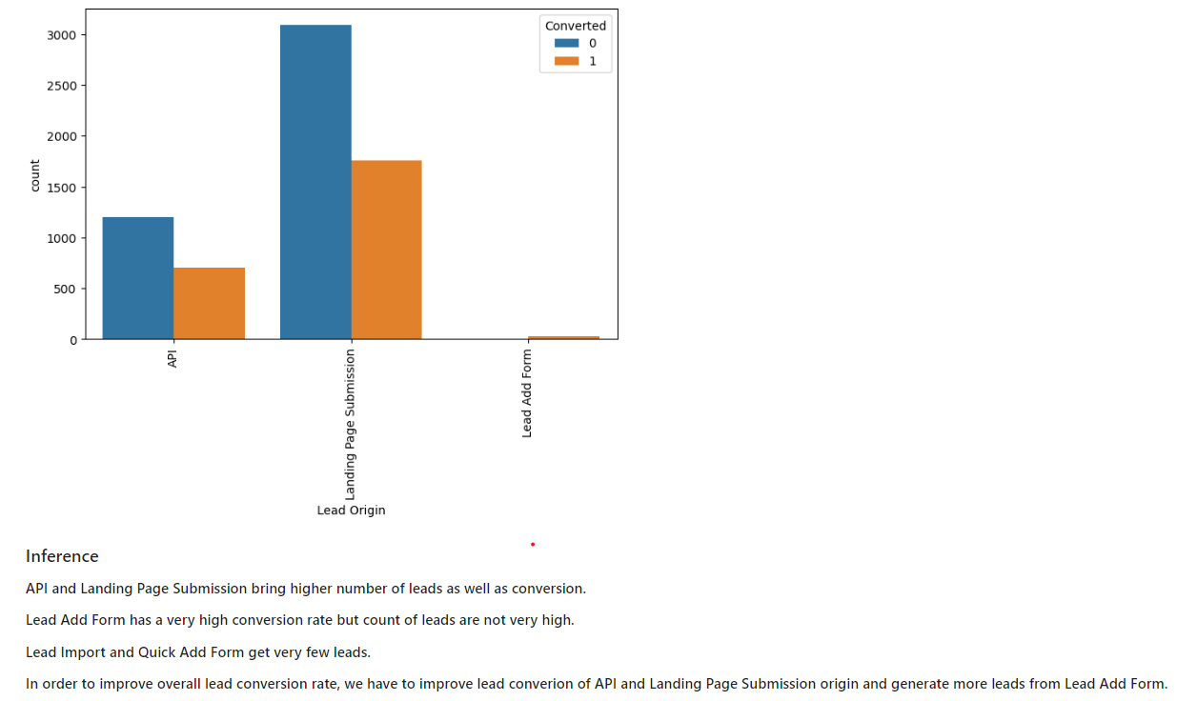
Count of Variable based on Converted value “Lead Origin”

Slide 10
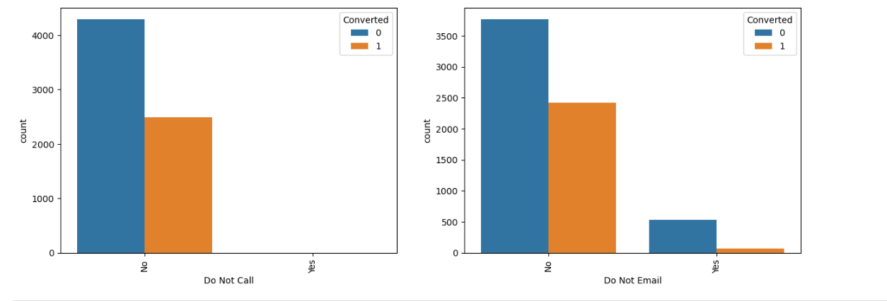
Count of Variable based on Converted value for “Do Not Email & Do Not Call”

Slide 11
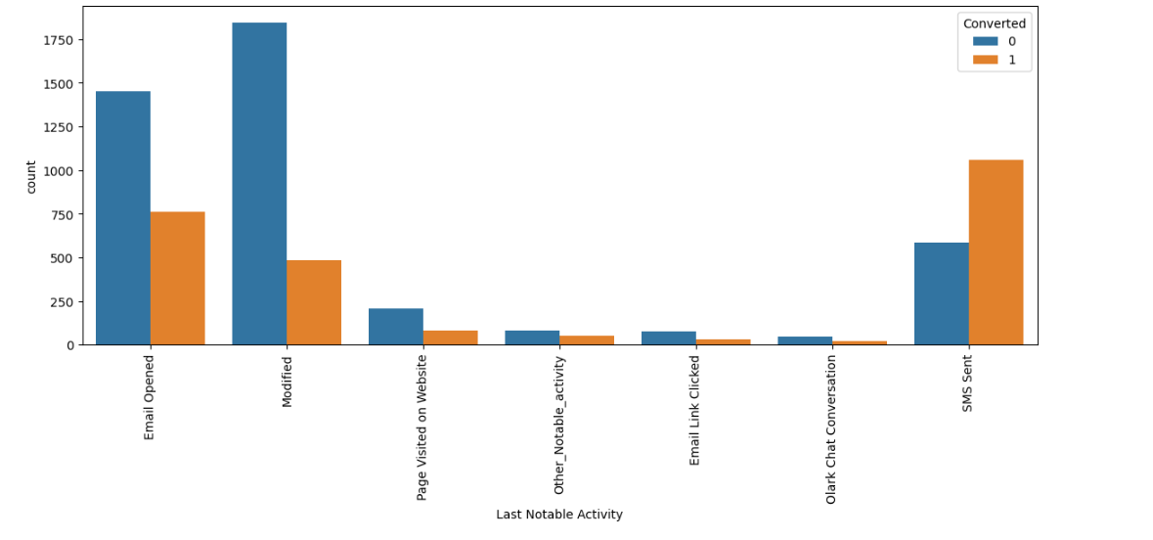
Count of Variable based on Converted value for “Last Notable Activity”

Slide 12
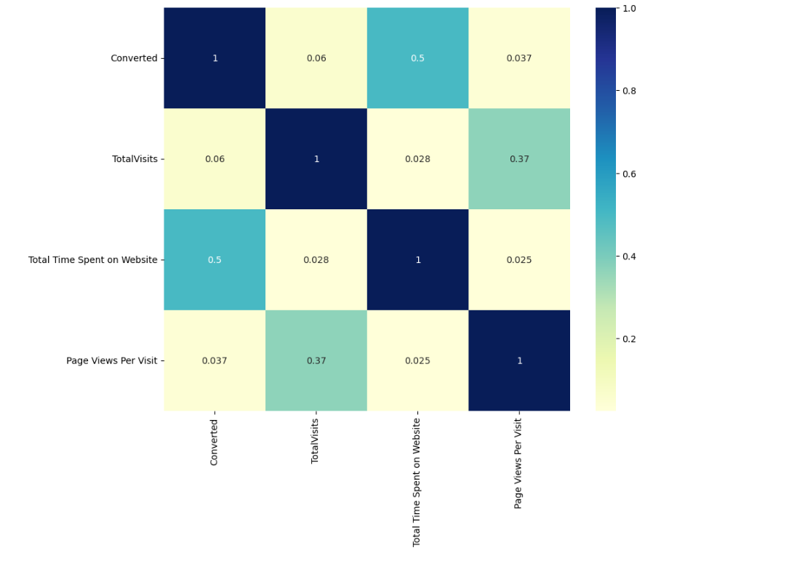
Checking correlations of numeric values using Heatmap

Slide 13
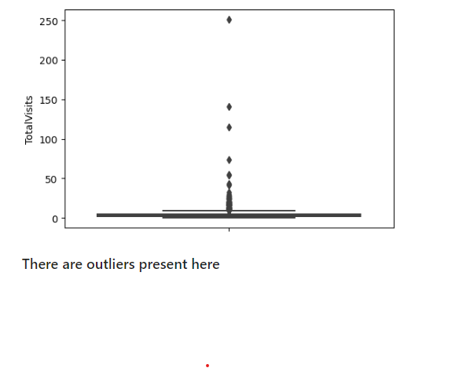
Visualizing spread of variable “Total Visits” boxplot

Slide 14
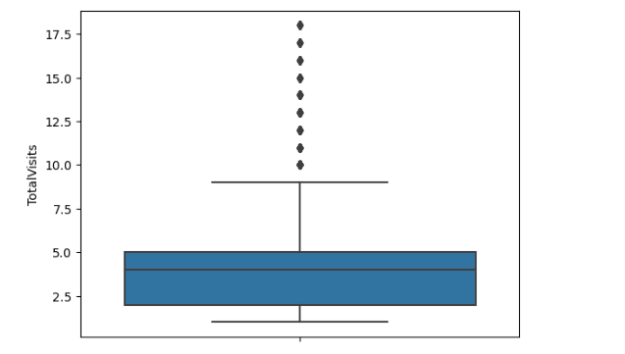
Checking percentile values for “Total Visits”

Slide 15
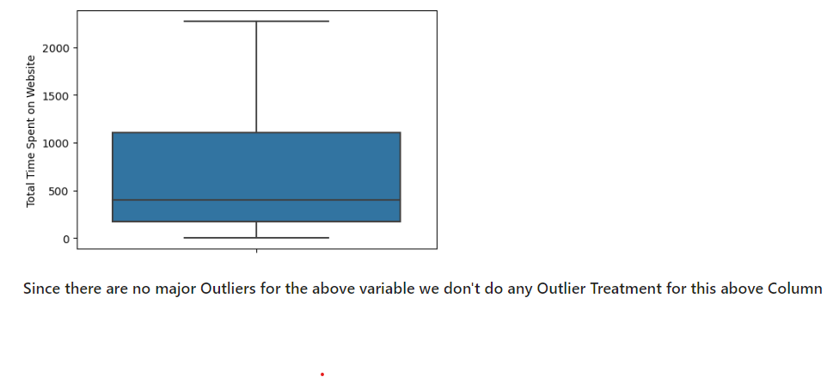
Visualizing spread of numeric variable “Total Time Spent on Website”

Slide 16
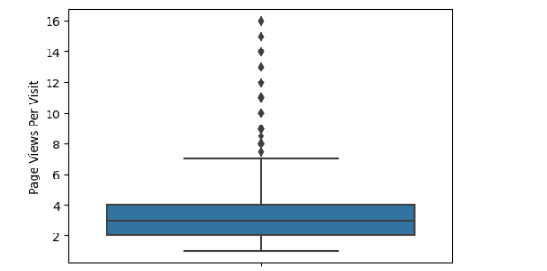
Visualizing spread of numeric variable “Page Views Per Visit”

Slide 17
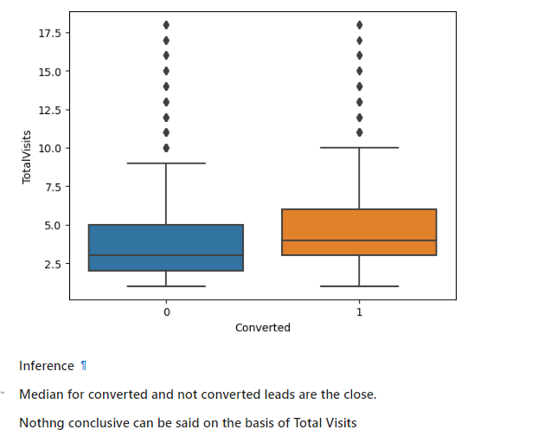
Checking Spread of “Total Visits” vs “Converted variable”

Slide 18
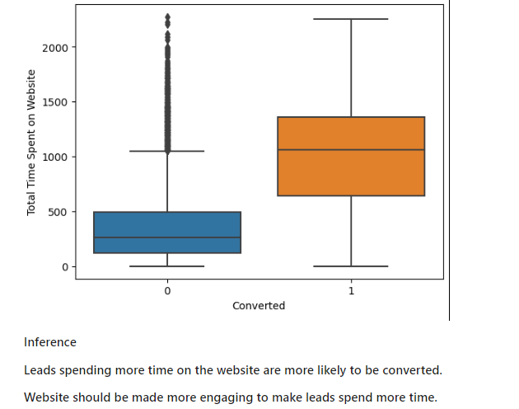
Checking Spread of “Total Time Spent on Website” vs “Converted variable”

Slide 19
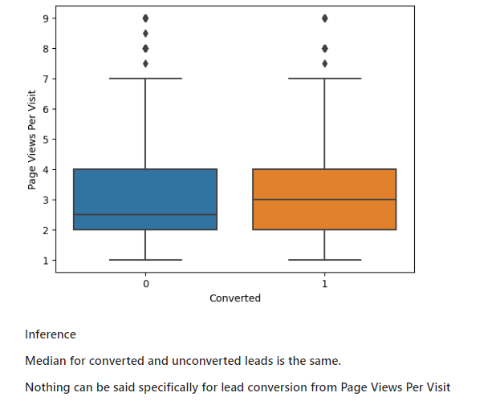
Checking Spread of “Page Views Per Visit” vs “Converted variable”

Slide 20
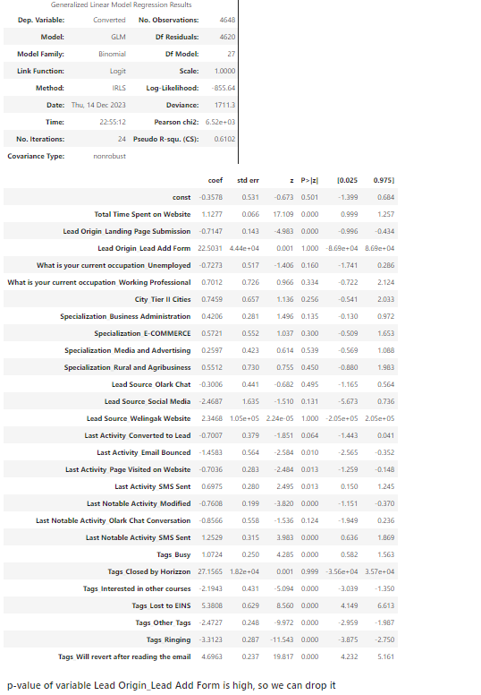
Model 1:-

Slide 21
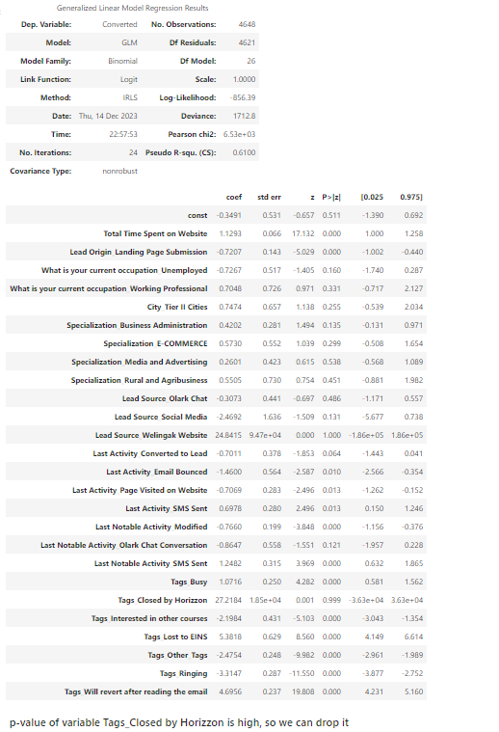
Model 2:-

Slide 22
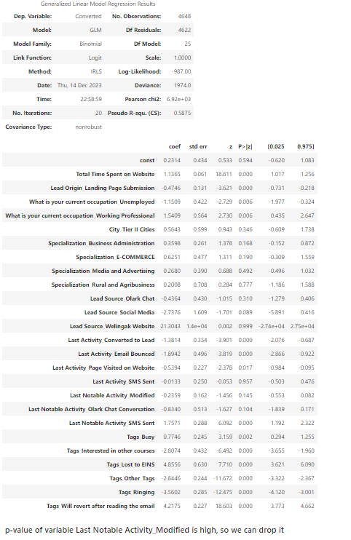
Model 3:-

Slide 23
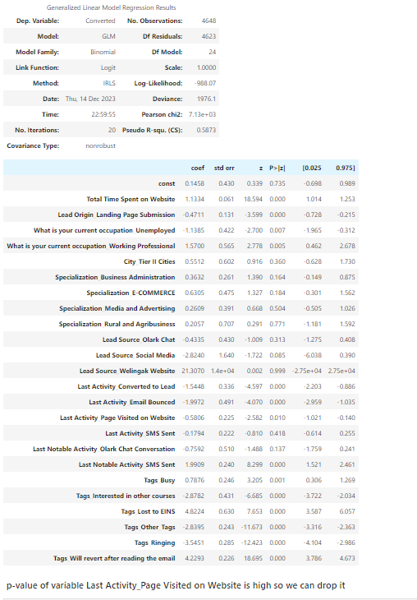
Model 4:-

Slide 24
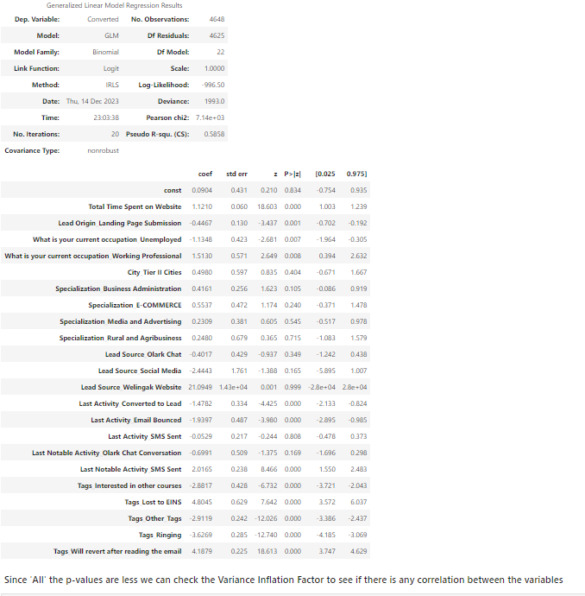
Model 6:-

Slide 25
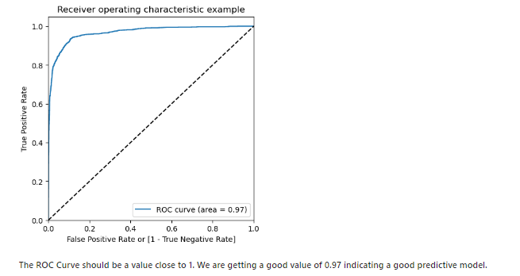
ROC Curve

Slide 26
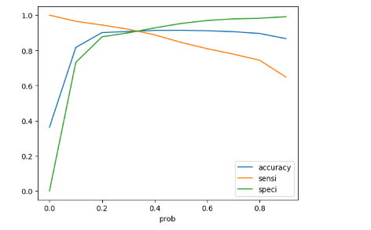
Accuracy Sensitivity and Specificity for various probabilities.

Slide 27
Observation: After running the model on the Test Data these are the figures we obtain: Accuracy : 90.91% Sensitivity : 89.78% Specificity : 91.57% Final Observation: Let us compare the values obtained for Train & Test: Train Data: Accuracy : 91.11% Sensitivity : 90.39% Specificity : 91.52% Test Data: Accuracy : 90.92% Sensitivity : 89.78% Specificity : 91.57% The Model seems to predict the Conversion Rate very well and we should be able to give the CEO confidence in making good calls based on this model.

